Slide 1
Student Dropout Problem
Predictable or not?

Slide 2
Our client
A widely known International College
Departments
Arts
Business
Computer Science
Engineering
Science
Our contract
Analyze student data and based on patterns that we will exclude, make predictions on the Dropout problem

Slide 3
The problem
WHY student dropout?
IS there a pattern this behavior follows?
HOW could we predict it?
Is a prediction explainable
WHAT policies a college could apply to reduce it

Slide 4
Our Data
10.000 student real cases
Features: Age, Gender, Income, Attendance, Delays, Travel time, Scholarship, Part time job, etc
Source: https://www.kaggle.com/datasets/meharshanali/student-dropout-prediction-dataset

Slide 5
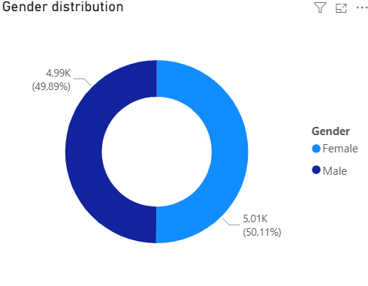
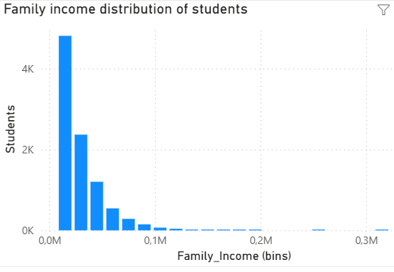
Data acquaintance

Slide 6
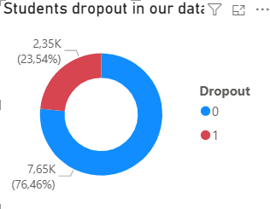
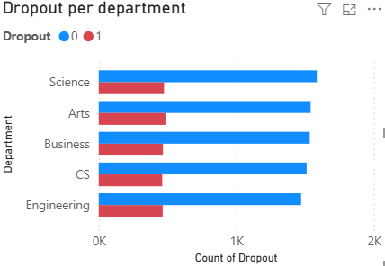
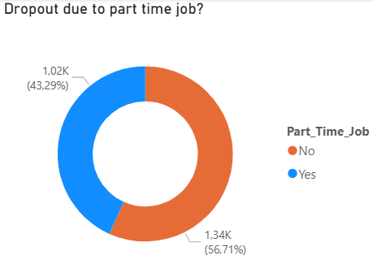
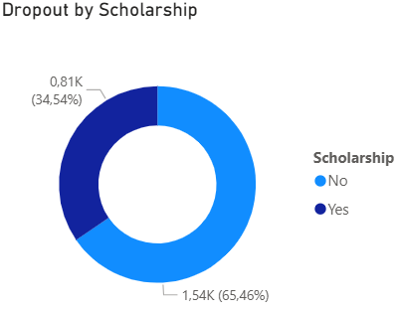
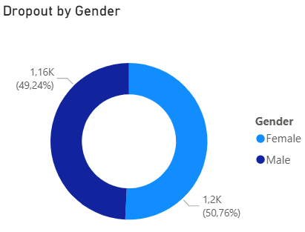
Drop outs per main features

Slide 7
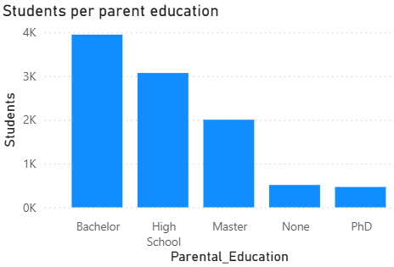
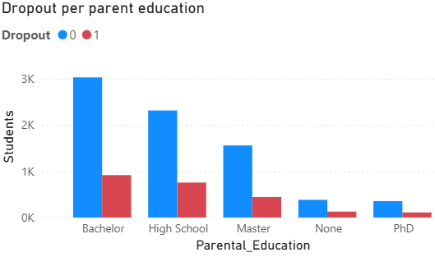
Parental education and Drop out

Slide 8
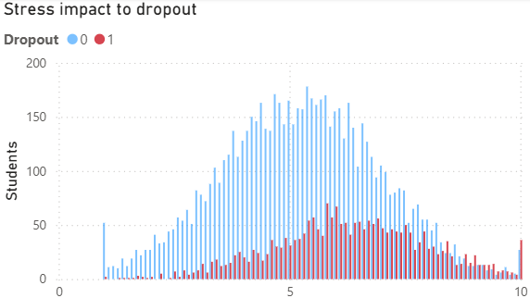
Impact of stress to Drop out

Slide 9
Our work outlined
Data preprocessing
Data exploration
Data understanding
Imbalances checking
Data modeling
Extensive machine learning application
Outcome
Our “DropOutOrNot?” model
Takes features of an individual student
Predicts probability to dropout
Advices how to handle

Slide 10
Model operational description
Input features of a student
Age: (years)
Gender: (Male / Female)
Family_Income: (Monthly family income)
Internet_Access: (Yes / No)
Study_Hours_per_Day: (Avg)
Attendance_Rate: (%)
Assignment_Delay_Days: (avg days)
Travel_Time_Minutes: (mins Daily commute)
Part_Time_Job: (Yes / No)
Scholarship: (Yes / No)
Stress_Index: Self-reported (1–10)
GPA, Semester_GPA, CGPA: Academic performance
Semester: (Year 1–4)
Department: Science, Arts, Business, CS, Engineering
Parental_Education (None, High School, Bachelor, Master, PhD
Output: Make the prediction
Dropout or not
Which features matter the most?

Slide 11
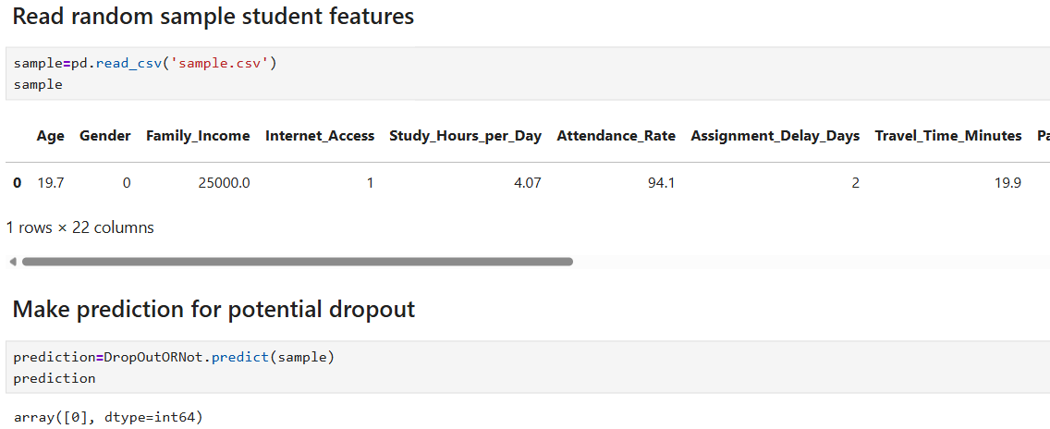
Model operational description

Slide 12
“DropOutOrNot?” Performance characteristics
Accuracy: 74 % (Correctly predicting cases generally)
Recall: 74 % (How many of the DropOuts our tool cached)
Precision (DropOut): 48 % (Probability a DropOut prediction to be True)
Precision (Retain) : 90% (Probability a Retain prediction to be True)
Main decision drivers
CGPA (Cumulative Grade Point Average) (negatively)
Stress Index (positively)
Attendance rate (negatively)

Slide 13
Next step: Pilot the product
Pick one department
i.e. Computer Science (CS)
Apply the “DropOutOrNot?” to every student
Evaluate predictions after one year
Take decision for keeping the engine or
Order a stronger engine
More data
Stronger models (Neural Networks)

Slide 14
Thank You
Katerina Lama
Manos Polydoros
Themis Mamatsopoulos

